Slide 1

Final Project

Slide 2

Shadow Mapping
By: Anees, Thuc, and Jesh
December 16/2020

Slide 3
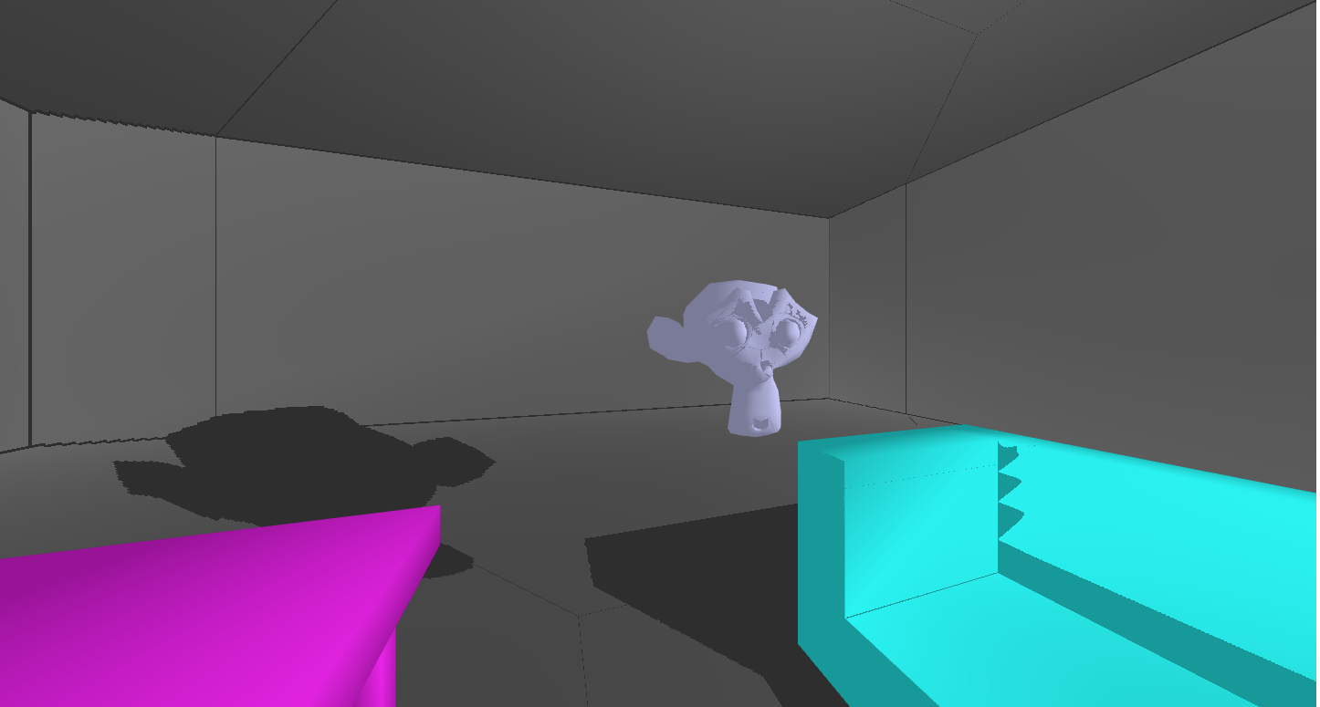
What is Shadow Mapping?
It is a process of projecting a shadow in which shadows get added to 3D computer graphics.
Shadows can give us a perspective about the relative location and motion of an object
In computer graphics, shadows analyzed based on different parameters:
Shadow texture
Shadow volume
Shadow map
Projective shadows

Slide 4
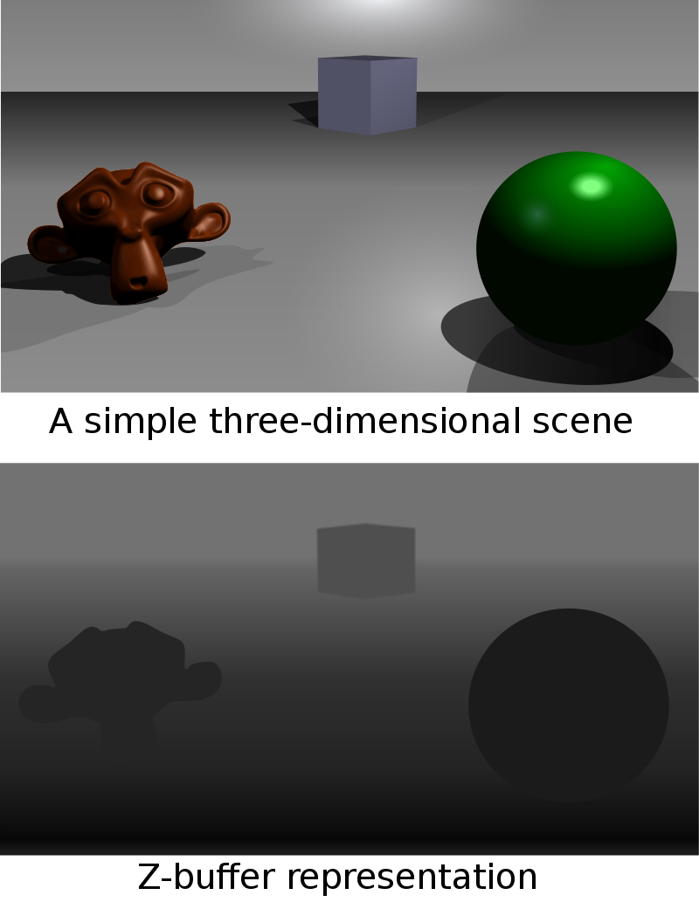
In this particular project we are interested ,and implemented shadow mapping.
Using a method called Z-buffer
render the scene from the light source using the Z-buffer algorithm
Z-buffer includes the distance to the object
Shadow depth map/shadow buffer
https://en.wikipedia.org/wiki/Z-buffering#/media/File:Z_buffer.svg

Slide 5
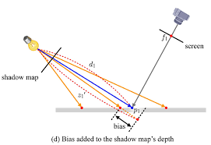

Render the scene from the view point
Calculate the coordinates of the tested points in each light space
If the rendered vertex is far from the value in the Z-buffer, it is in the shadow
Drawing the Shadow
We use the matrix that transforms an object into its shadow
Draw the triangle/polygon
we multiply the shadow matrix into the model transformation
Reconstruct the object in grey

Slide 6

GL-matrix Library
This library is a set of tools which you can use to work with you matrices for 3D animations.
Some of it which we used are as follow:-
Download Link: https://github.com/toji/gl-matrix/releases/tag/v3.3.0

Slide 7
mat4.rotate(out, a, rad, axis)
* Rotates a mat4 by the given angle around the given axis
* out: the receiving matrix
* a: the matrix to rotate
* rad: the angle to rotate the matrix by
* axis: the axis to rotate around
* returns → out (Matrix 4X4)

Slide 8
mat4.perspective(out, fovy, aspect, near, far)
* Generates a perspective projection matrix with the given bounds
* out: mat4 frustum matrix will be written into
* fovy: Vertical field of view in radians
* aspect: Aspect ratio. typically viewport width/height
* near: Near bound of the frustum
* far: Far bound of the frustum
* return → out (Matrix 4X4)

Slide 9
mat4.scale(modelview-x, modelview-y, [dx, dy, dz])
Multiply the matrix stored in Matrix4 by the scaling matrix,
with scaling factors x, y, and z, storing the results back into
Matrix4.

Slide 10
mat4.translate(modelview-x , modelview-y, [dx, dy, dz])
Multiply the matrix stored in Matrix4 by the translation matrix, which translates x units in the direction of the x-axis.
y units in the direction of the y-axis.
z units in the direction of the z-axis, storing the result back into Matrix4 that represents the translation.

Slide 11
mat4.lookAt(out, eye, center, up)
* Generates a look-at matrix with the given eye position, focal point, and up axis
* out: mat4 frustum matrix will be written into
* eye: Position of the viewer
* center: Point the viewer is looking at
* up: vec3 pointing up
* returns → out (Matrix 4X4)

Slide 12
mat4.rotate(modelview-x, modelview-y, modelview-z, radians, [dx, dy, dz]);
Multiply the matrix stored in Matrix4 by the rotation matrix, which rotates angle degrees around the rotation axis (x, y, z), storing the results back into Matrix4.
In other words, this function specifies the axis of rotation as the line (0,0,0) to a point (dx, dy, dz).
The (x, y, z) coordinates do not need to be normalized.

Slide 13
Live Demo
Use Keys to play with project
W to move Forward
S to move backward
A to move left
D to move right
Arrow Up to move Upwards
Arrow Down to move Downwards
Arrow Right to rotate clockwise
Arrow Left Rotate anticlockwise
Link: https://aneesurrehman001.github.io/cs460_final/

Slide 14
Work In-progress . . .
Fixing Bugs and errors in the update version of the project.
Small demo is on the following slide.

Slide 15

W A S D - to control

